Slide 1

Organizational Visit : Bashundhara Group(Industrial Headquarters-1)
Course Name: Business Studies for Engineers Course code: BUS 405
Supervised By,
Md. Iftekharul Amin
Assistant Professor
Institute of Business Administration,
University of Dhaka

Slide 2
Presented By,
Group Four:
Shahla Shaan Ahmed (BSSE0810)
Taslima Binte Kamal (BSSE0835)

Slide 3
Presentation Outline:
Aim of the Visit
About the Organization
Organization’s Mission and Vision
Organization Structure
Recruitment
Socialization
Training and Promotion
Culture

Slide 4
Aim of the Visit
Actual view of an organization.
Understand their vision.
Understanding culture
Understanding working environment.
Managerial hierarchy.
Manager-employee relation.
Recruitment
Socialization process

Slide 5

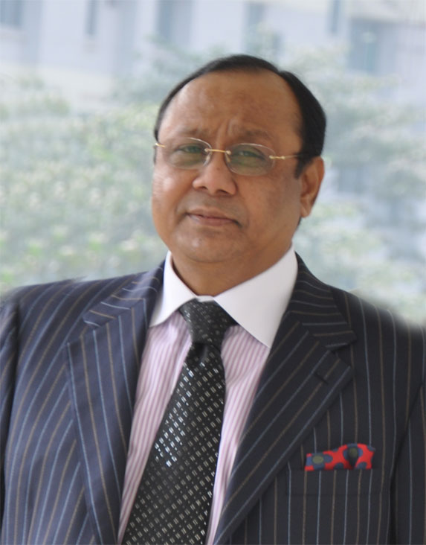
About the Organization:
Started as “Bashundhara” under the tutelage of “The East West Property Development(Pvt) Ltd” in 1987.
Was Founded By Ahmed Akhbar Sobhan.
Has over 20 major concerns with approximately 8,100 employees.
Owns Bangladesh Dailies such as: The Kaaler Kantha and Bangladesh Pratdin and English Dailies such as: Daily Sun.

Slide 6

The organization also owns a bilingual online portal named “banglanews24.com”.
Current value of the total assets is approximately TK. 15,000 million equivalent to approximately US $300 million.
Total turn over of the business amounts to around TK. 16000 million.

Slide 7
For the People, For the Country

Slide 8
Organization’s Mission and Vision
Creating affordable housing.
Fostering better living environment.
Ensuring environmental balance
Ensuring sustainability.
Using re-cycled raw materials.

Slide 9
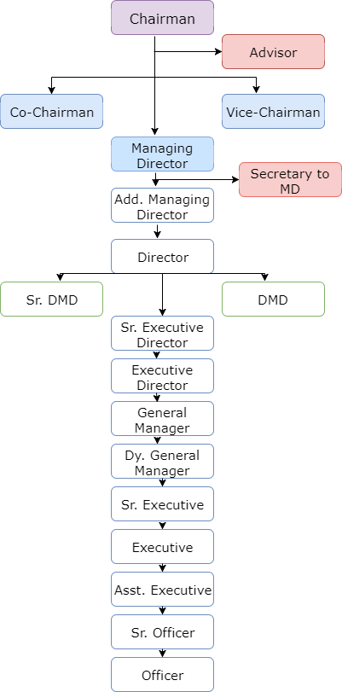
Organization’s Structure

Slide 10
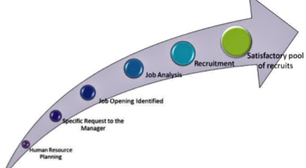
Recruitment:
.

Slide 11
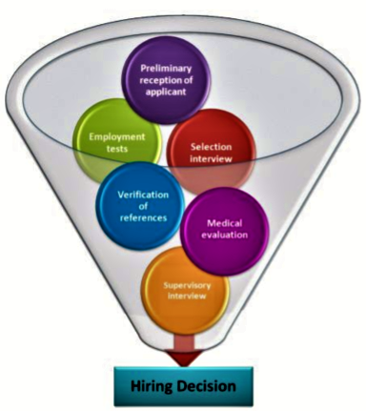
Recruitment:

Slide 12
Socialization Process:
Initial Introduction
Given Time
Interaction through Regular Work

Slide 13
Training:
Specialized Training
Example: Advanced Managerial Communication Training
Wokrshop
Disciplinary Action on Process & Procedure

Slide 14
Promotion:

Slide 15
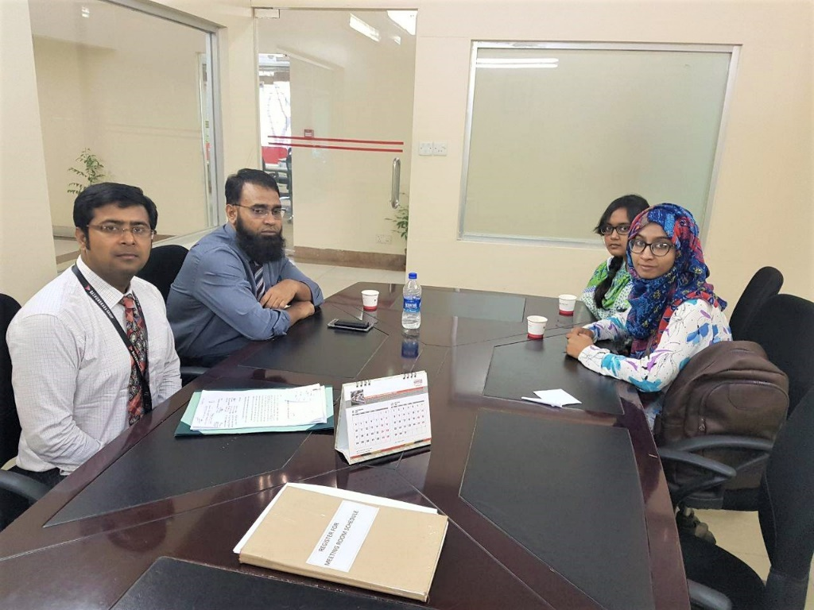
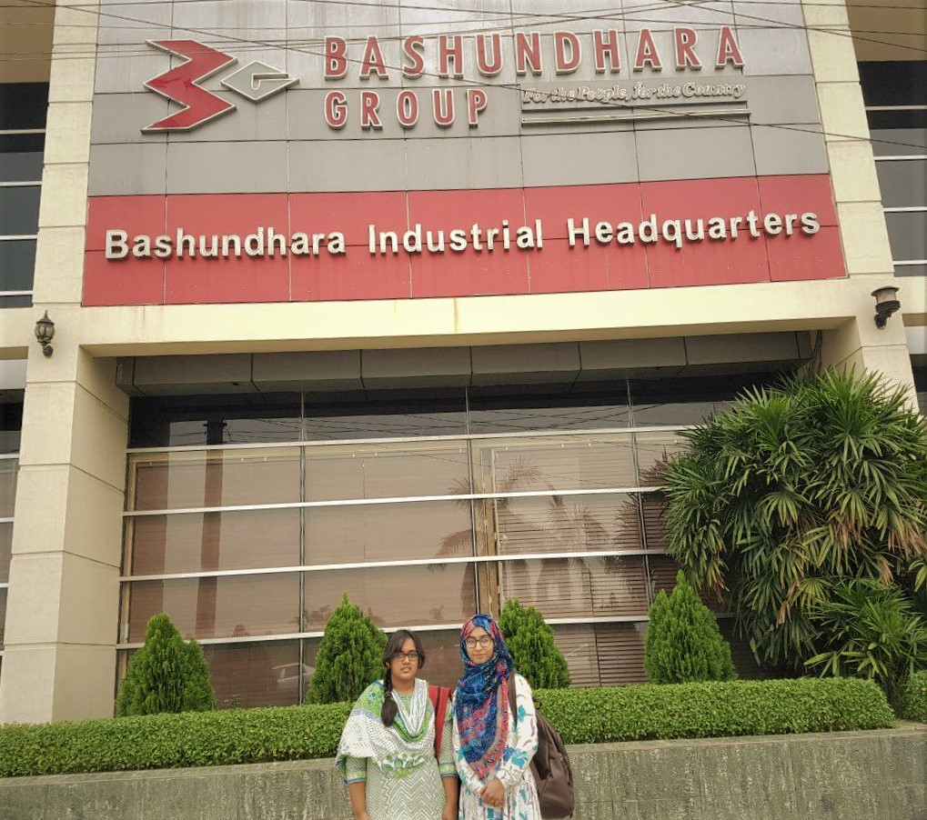
Organization Visit:

Slide 16
Thank You!

